Slide 1

Phishing awareness Training

Slide 2
Content slide
What is Phishing Attacks?
Common Types of Phishing Attacks
How Recognize Phishing Attacks
Ways to Avoid Phishing Attacks
* Emails
* Website
* Social engineering tactics

Slide 3

Common types of phishing attacks

Slide 4
Email Phishing – the attacker will register a fake domain that mimics a genuine organization and sends thousands of generic requests.
Spear Phishing – this describes malicious email sent to a specific person. This is most done by attacker who has already have some of your information.
Whaling – whaling are even more targeted, taking aim a senior executives. Whaling emails also commonly use the pretext of a busy CEO or executive who want an employee to do them a favor.
Smishing and Vishing – smishing involves criminals sending text messages and vishing involves a telephone conversation. Smishing text may contains links that direct recipient to a website controlled by the fraudster and design to capture your sensitive information.
Angler Phishing – a relatively new attack vector, social media offers several ways for criminals to trick people. False URLs, cloned website, posts, tweets and instant messaging can all be used.

Slide 5
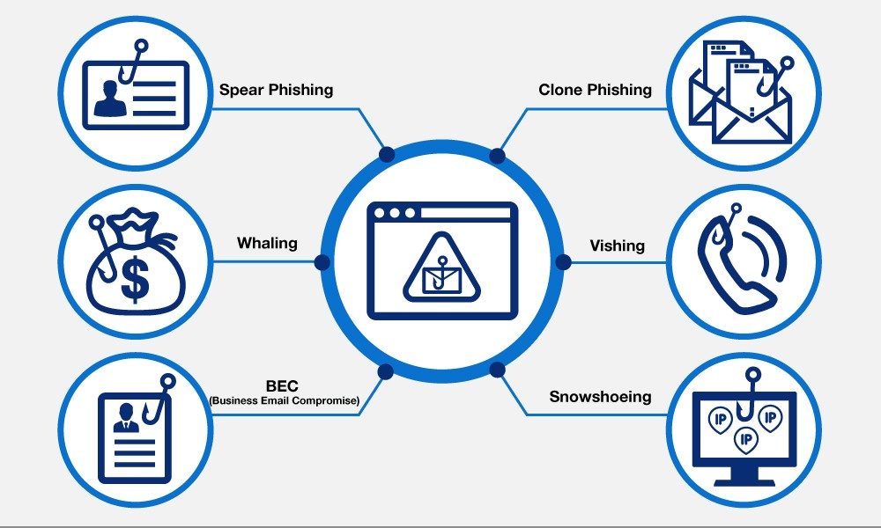
Slide title 29

Slide 6
HOW TO RECOGNIZE PHISHING ATTACKS

Slide 7
Emails or text messages demanding urgent actions.
Emails threatening a negative consequences or a loss of opportunity unless urgent action is taken. Attackers usually rush the recipient to respond.
Emails or text messages with grammar error or spelling mistakes.
Emails and text messages with bad grammar or spelling mistakes. Many legitimate companies apply spelling checking tools at out going mails and messages so emails and messages with bad grammar and spelling mistakes should suspicious.
Emails, text messages or phone calls with unfamiliar greetings.
Emails or text messages exchanged between work colleagues usually have a formal salutation. Those that contains phrases not normally used are from unfamiliar sources, so these kinds of communication should raise suspicions.
Suspicious attachments
Most related business or work related files sharing takes place via collaboration tools such as sharepoint, onedrive or dropbox. Therefore emails with attachments should be treated suspiciously.
Emails or text messages requesting login credentials, payment information or sensitive data.
Emails and text messages originating from unexpected or unfamiliar sender that request login credentials, payment information or other sensitive data.
Too good to be true emails or text messages
These emails or text messages which incentivize the recipient to click on a link or open an attachment claiming there will be rewards of some nature.

Slide 8
WAYS TO AVOID PHISHING ATTACKS

Slide 9
Protect your computer by using security software.
You must set a software to update automatically so it will deal with any new security threats.
Protect your cellphone by setting software to update automatically.
These update could give you critical protection against security threat.
Protect you account by using multi-factor authentication.
Some account offer extra security by requiring two or more credentials to log in to your account.
Protect your data by backing it up.
Back up your data so that if attackers steal your data you can restore it from cloud or drive.
Ask for ID or access card/badge to avoid social engineering tactics.
Always ask for access card, ID or badge before a person enters a specific organization.
Use biometric for access.
Use of biometric to enter an organization prevent an unwanted traffic to enter without authorization.

Slide 10
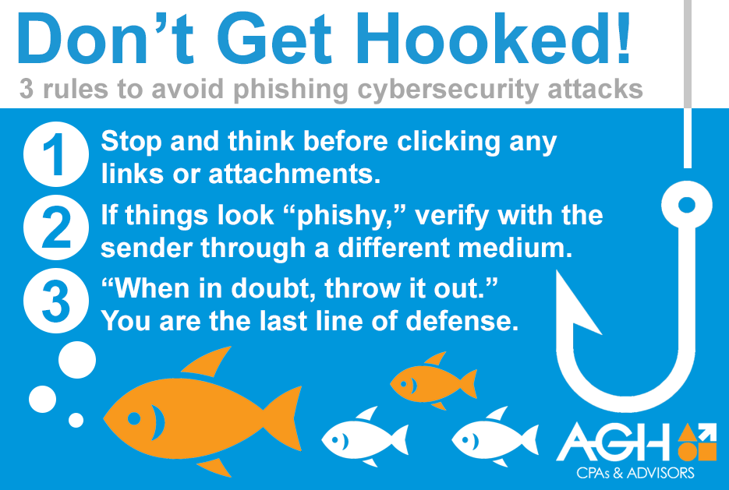
Slide title 29

Slide 11
THANK YOU

